Slide 1
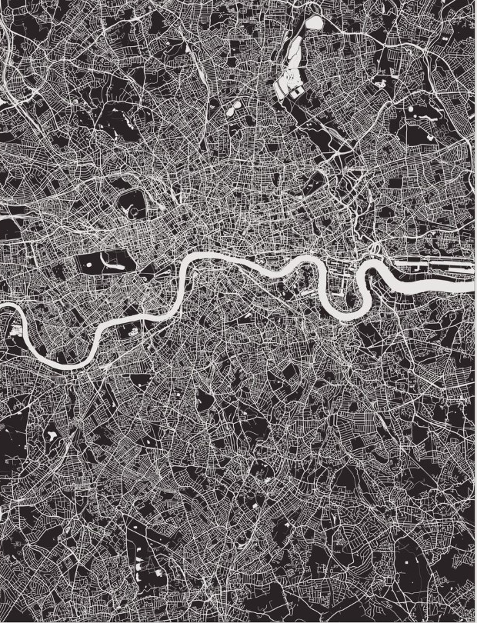


London Boroughs Clustering
IBM Data Science Professional Certificate
Capstone Project
Tomás Bertoglia
Munich, 26. Jun 2020

Slide 2
Two Challenges one Result
Our stakeholder requires a selection of boroughs to place his coffee schop chain.
Hig-end customer affluence and suitable commercial profile are the requirements.
The ultimate goals: guarantee brand positioning and business success.

Slide 3
Data & Preparation
Boroughs and Coordinates Dataset crawled from wikipedia: https://en.wikipedia.org/wiki/List_of_London_boroughs
BeautifulSoup used for scrapping.
Demographc Data downloaded from Greater London Authority (GLA) website: https://data.london.gov.uk/dataset/london-borough-profiles
6 out of 81 Features selected.
StandardScaler package used for normalization
Venues Data obained through the Foursquare API: https://api.foursquare.com/v2/venues/explore

Slide 4
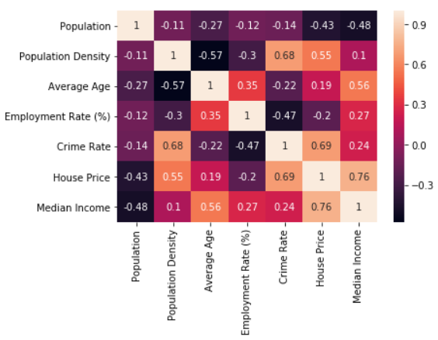
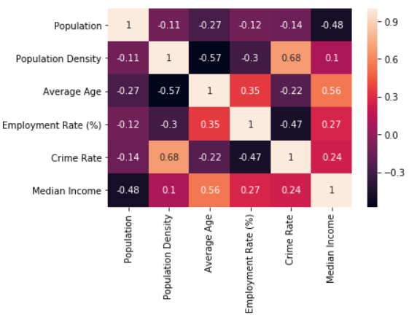
Data & Preparation
Demographc Data: Features Selection: high correlation between ‚House Price‘
and 3 other Features suggest his removal.

Slide 5
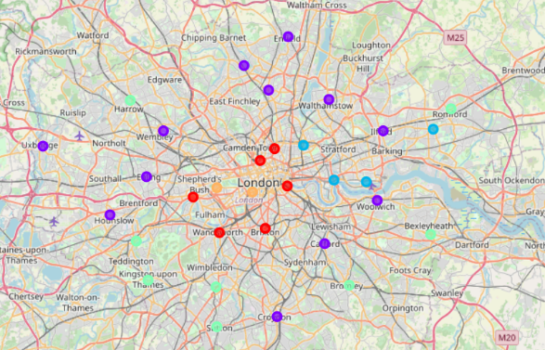
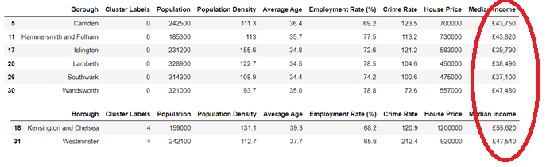
Demographic Clustering
Main aim: guarantee high-end customer profile required by the stakeholder:
Special focus put in clusters with ‚High Median Income‘
Central location of boroughs also favored

Slide 6
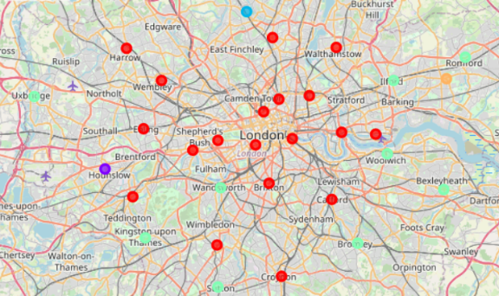
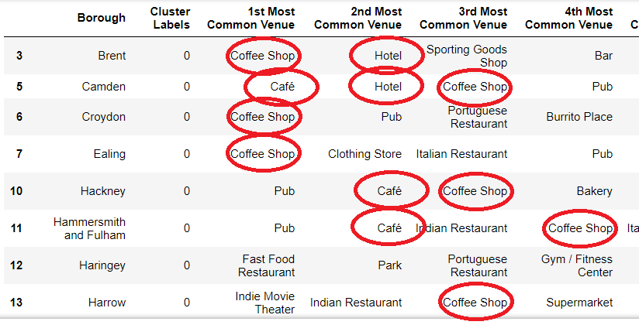
Clustering by Venues
Main aim: guarantee the selection of suitable boroughs for the coffee shop chain:
Focus on clusters with high presence of Coffee shops and Cafés
Attention to complimentary source of target customers such as Hotels

Slide 7
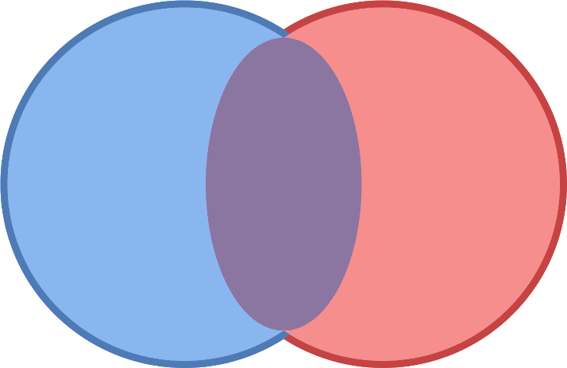
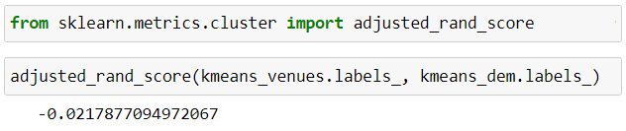
LOW ARI SCORE: Intersection required
A low ARI Score suggest independent logics under the 2 clustering logics empoyed
Both logics should be combined to fulfill the requirements of our Stakeholder
Intersection of the Boroughs selected after clustering selection will be applied

Slide 8
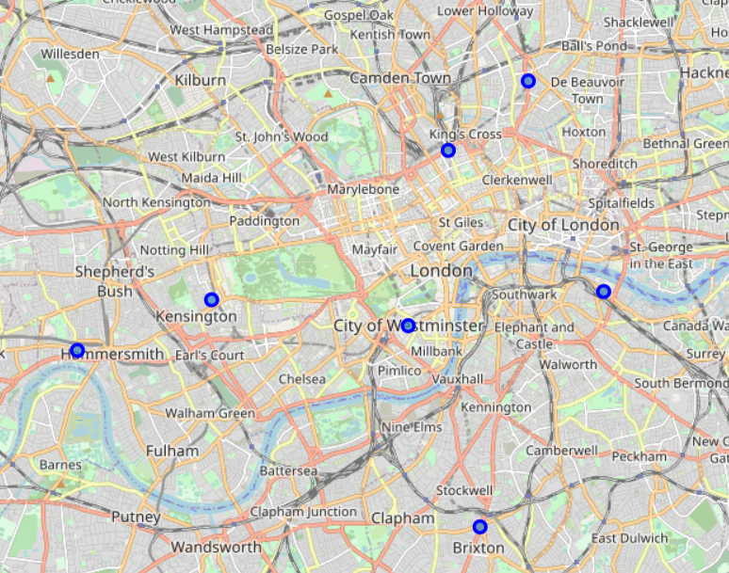
Final Results
Camden
Hammersmith and Fulham
Islington
Kensington and Chelsea
Lambeth
Southwark
Westminster
The intesection of the last step provided a short list of 7 boroughs
Those boroughs fulfill both, the market potential and customer profile requirements.

Slide 9
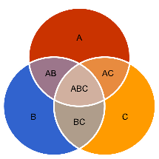
Conclusion & Further requirements
Very often, we would need to combine different procedures to attend our stakeholder‘s requirements.
The intersection of results is a great and escalable tool to satisfy multiple requirements
In a real-life scenario, clsoe participation of our stakeholders could hel pus further refine our results

Slide 10
Thanks for your attention

